Slide 1
Indicators mapping for health ouput indicators

Slide 2
OpenRBF and DHIS

Slide 3
Needs for interoperability
Comparison / Validation
Need exact matching
Want a lot of control on mapping
Completion
Need to understand definition
Can involve multiple systems
Co-Analysis
Need to understand relationships

Slide 4
Interoperability
Technical
Semantic
Organizational

Slide 5
Interoperability
Technical
Semantic
Organizational

Slide 6
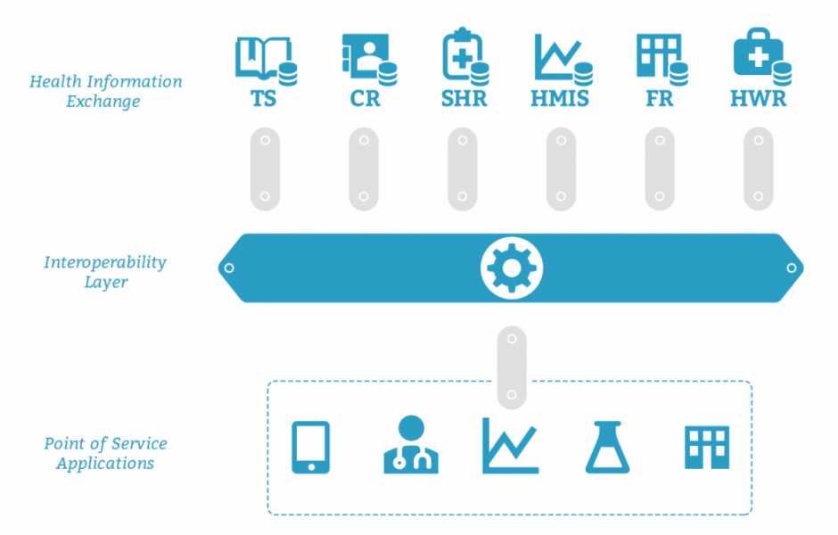

Slide 7
Structured tagging approach
service
population
Indicator ID | Indicator Name | Indicator Category | ICD10 | Service | Additional | Age Inf | Age sup | Gender | Other
HMIS121 | HIV+ followed without ART | Women – 0-14 yo | B20 | Consultation | Yes | 0 | Y14 | F | NA
HMIS122 | HIV+ followed without ART | Women – 15-24 yo | B20 | Consultation | Yes | Y15 | Y24 | F | NA

Slide 8
Test
Usability
Differenciation
Mapping

Slide 9
Bénin example - Usability
RBF : 39 indicators, 38 coded
DHIS : 9188 indicators, 439 fulley classified, 8665 partially

Slide 10
Bénin example - Differenciation
No duplicate

Slide 11
Bénin example – mapping
Linear additive metric for distance
Manual validation set
 | Mapping | No Mapping
Manual Match | 15 | 6
No Manual Match | 5 | 13

Slide 12
Questions
Inputs / remarks on generalizability
Critics on the system
Links to existing tools

